Slide 1
Computer Architecture Experiment
Topic 5. Pipelined CPU supporting multi-cycle operations
浙江大学计算机学院

Slide 2
Outline
Experiment Purpose
Experiment Task
Basic Principle
Operating Procedures
Checkpoints

Slide 3
Experiment Purpose
Understand the principle of pipelines that support multicycle operations.
Master the design methods of pipelines that support multicycle operations.
Master verification methods of pipelined CPU supporting multicycle operations.

Slide 4
Experiment Task
Redesign the pipelines with IF/ID/FU/WB stages and FU stage supporting multicycle operations.
Redesign of CPU Controller.
Verify the Pipelined CPU with program and observe the execution of program.

Slide 6
Pipelines resolving Data Hazards

Slide 7
Methods of resolving Control hazards
Predict-not-taken
Condition and Addr. Calculation in FU

Slide 8
Instr. Mem.(1)
NO. | Instruction | Addr. | Label | ASM | Comment
0 | 00000013 | 0 | __start: | addi x0, x0, 0
1 | 00402103 | 4 |  | lw x2, 4(x0) | x2=0x8
2 | 00802203 | 8 |  | lw x4, 8(x0) | x4=0x10
3 | 004100b3 | C |  | add x1, x2, x4 | x1=0x18
4 | fff08193 | 10 |  | addi x3, x1, -1 | x3=0x17
5 | 00c02283 | 14 |  | lw x5, 12(x0) | x5=0x14
6 | 01002303 | 18 |  | lw x6, 16(x0) | x6=0xFFFF0000
7 | 01402383 | 1C |  | lw x7, 20(x0) | x7=0x0FFF0000
8 | 40220433 | 20 |  | sub x8, x4, x2 | x8=0x8
9 | ffd50493 | 24 |  | addi x9, x10,-3 | x9=0xFFFFFFFD
10 | 00520c63 | 28 |  | beq x4, x5, label0 | no jump
11 | 00420a63 | 2C |  | beq x4, x4, label0 | jump to 0x40
12 | 03000a13 | 30 |  | addi x20,x0, 48 | not executed
13 | 03400a13 | 34 |  | addi x20,x0, 52 | not executed
14 | 03800a13 | 38 |  | addi x20,x0, 56 | not executed

Slide 9
Instr. Mem.(2)
NO. | Instruction | Addr. | Label | ASM | Comment
15 | 03c00a13 | 3C |  | addi x20,x0,60 | not executed
16 | 00004537 | 40 | label0: | lui x10,4 | x10=0x4000
17 | 014005ef | 44 |  | jal x11,20 | x11=0x48
18 | 04800a13 | 48 |  | addi x20,x0,72 | not executed
19 | 04c00a13 | 4C |  | addi x20,x0, 76 | not executed
20 | 05000a13 | 50 |  | addi x20,x0, 80 | not executed
21 | 05400a13 | 54 |  | addi x20,x0, 84 | not executed
22 | ffff0617 | 58 |  | auipc x12, 0xffff0 | x12=0xFFFF0058
23 | 0223c6b3 | 5C |  | div x13, x7, x2 | x13=0x01FFE000
24 | 02520733 | 60 |  | mul x14, x4, x5 | x14=0x140
25 | 022687b3 | 64 |  | mul x15, x13,x2 | x15=0x0FFF0000
26 | 00400813 | 68 |  | addi x16, x0, 4 | x16=0x4
27 | 000008e7 | 6C |  | jalr x17, 0(x0) | x17=0x70

Slide 10
Data Mem.
NO. | Data | Addr. | Comment
0 | 000080BF | 0
1 | 00000008 | 4
2 | 00000010 | 8
3 | 00000014 | C
4 | FFFF0000 | 10
5 | 0FFF0000 | 14
6 | FF000F0F | 18
7 | F0F0F0F0 | 1C
8 | 00000000 | 20
9 | 00000000 | 24
10 | 00000000 | 28
11 | 00000000 | 2C
12 | 00000000 | 30
13 | 00000000 | 34
14 | 00000000 | 38
15 | 00000000 | 3C
NO. | Instruction | Addr. | Comment
16 | 00000000 | 40
17 | 00000000 | 44
18 | 00000000 | 48
19 | 00000000 | 4C
20 | A3000000 | 50
21 | 27000000 | 54
22 | 79000000 | 58
23 | 15100000 | 5C
24 | 00000000 | 60
25 | 00000000 | 64
26 | 00000000 | 68
27 | 00000000 | 6C
28 | 00000000 | 70
29 | 00000000 | 74
30 | 00000000 | 78
31 | 00000000 | 7C

Slide 11
Test Bench
RV32core core(
.debug_en(1'b0),
.debug_step(1'b0),
.debug_addr(7'b0),
.debug_data(),
.clk(clk),
.rst(rst),
.interrupter(1'b0)
);
initial begin
clk = 0;
rst = 1;
#2 rst = 0;
end
always #1 clk = ~clk;

Slide 12
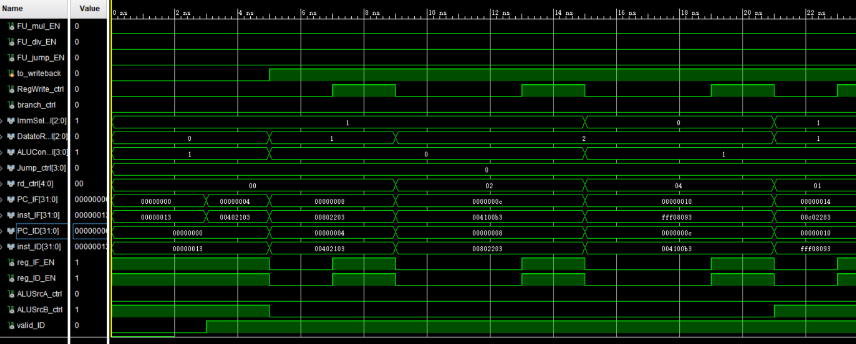
Simulation (1)

Slide 13
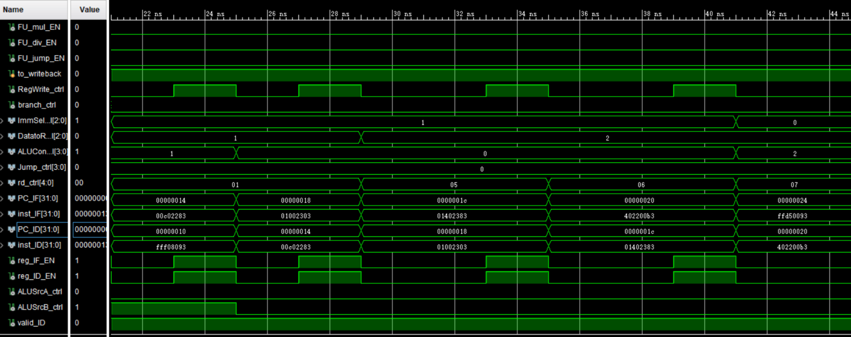
Simulation (2)

Slide 14
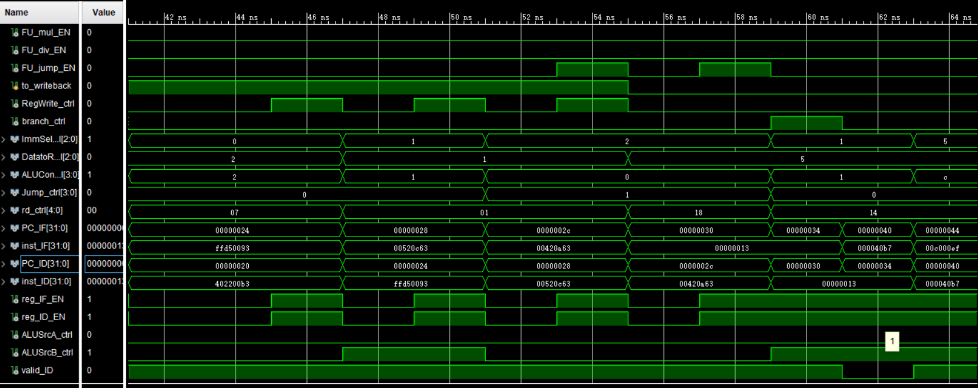
Simulation (3)

Slide 15
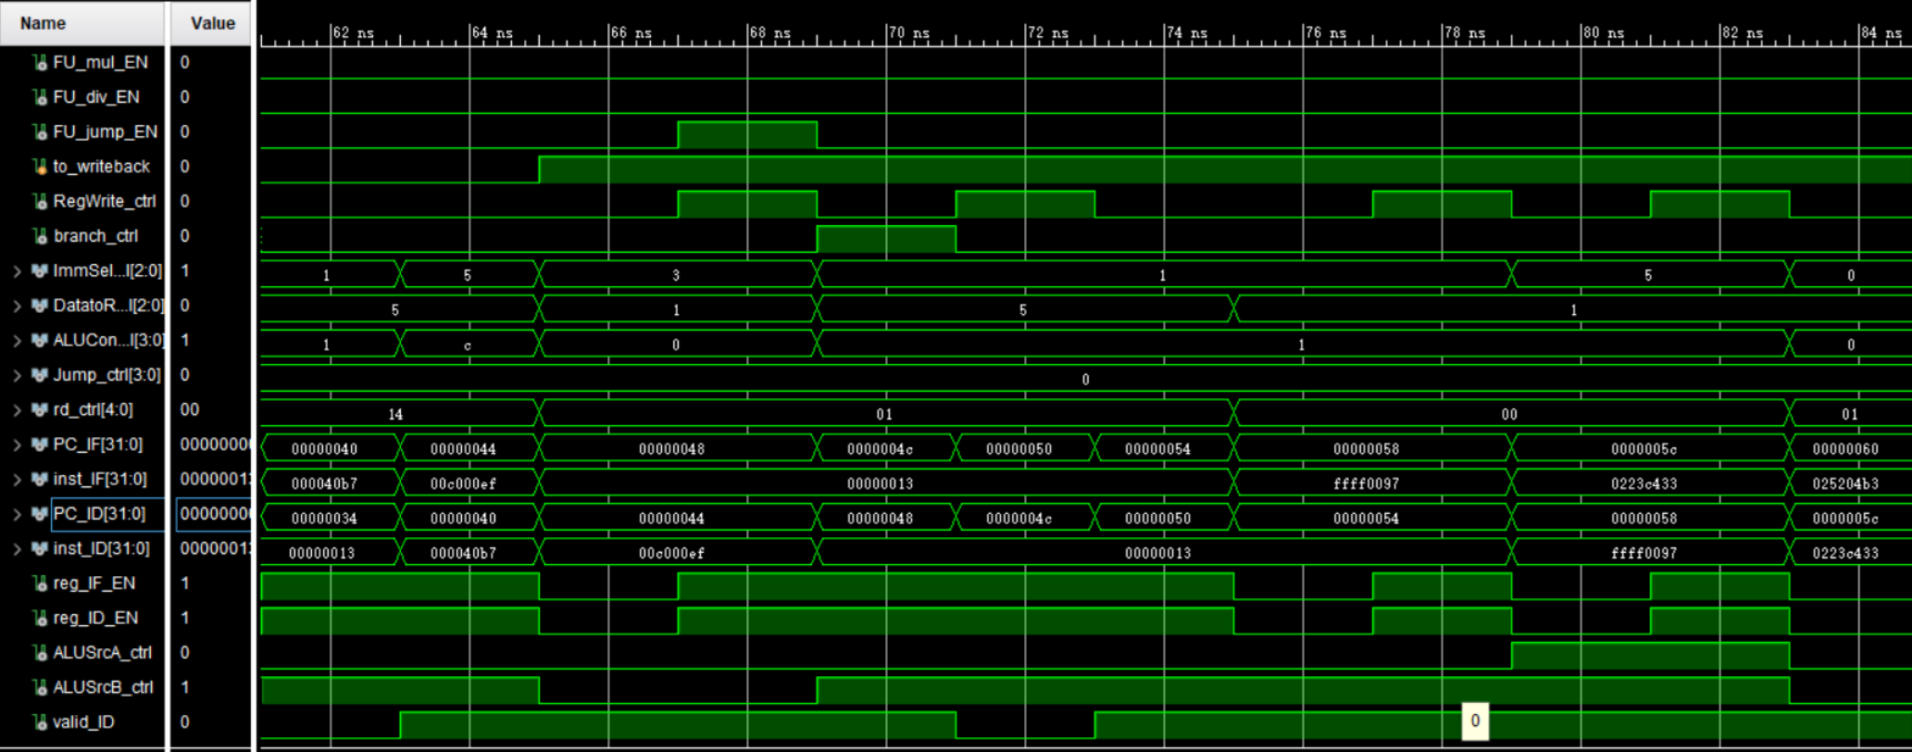
Simulation (4)

Slide 16
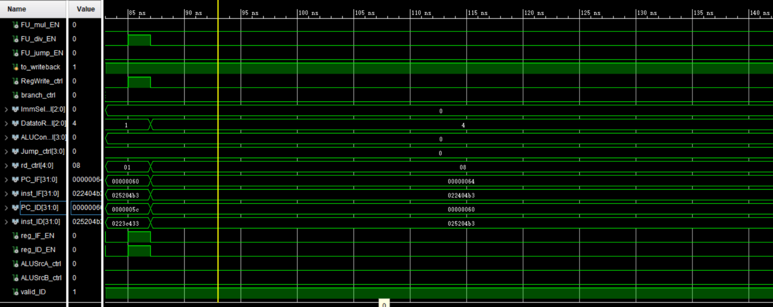
Simulation (5)

Slide 17
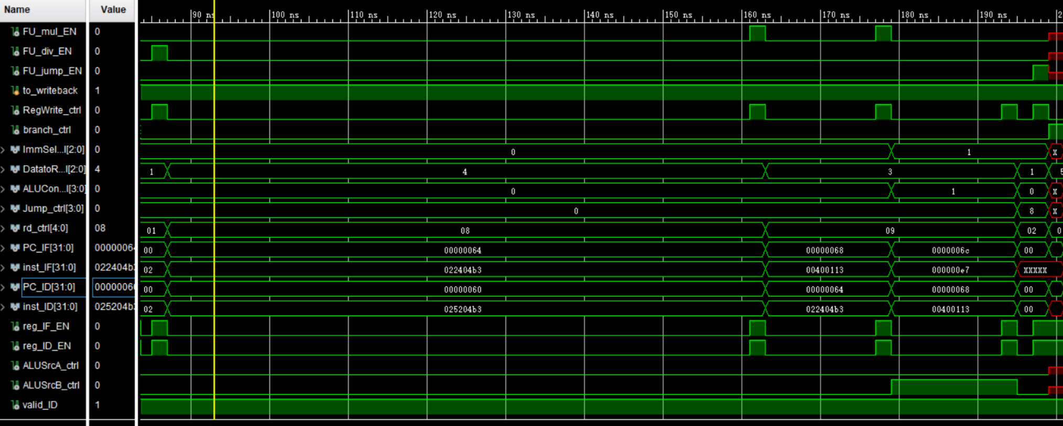
Simulation (6)

Slide 18
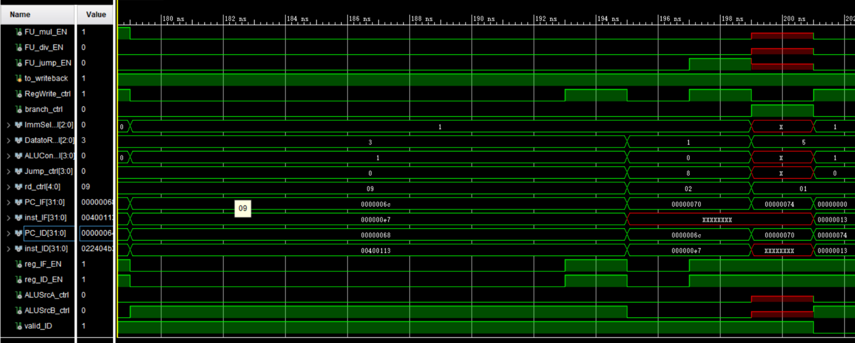
Simulation (7)

Slide 19
Checkpoints
CP 1:
Waveform Simulation of the Pipelined CPU with the verification program
CP 2:
FPGA Implementation of the Pipelined CPU with the verification program

Slide 20
Thanks!

